Slide 1
Python- Introduction
-Yilian Zhang

Slide 2
Python
Python is a general purpose, high level programming language that is used in a variety of application domains.
Syntax of a programming language
Easier than a new foreign Language
BUT
Precise
Accurate
Great attention to details
Formal Python Documentation: https://docs.python.org/3/
Build-in Function: https://docs.python.org/3/library/functions.html
Notes:
Please always remember that you are talking to a machine. No tolerance on any mistake!!!

Slide 3
Talk to python
Start Python Shell/ipython and talk to Python
>>> 3 + 5
8
>>> (3 + 5) * 2 - 1
15
>>> 10 ** 3 <- What is this operator ?
1000
>>> 52 % 10 <- What is this operator ?
2

Slide 4
Arithmetic Operations
+ addition
- subtraction or negation
* multiplication
/ division
( ) parentheses for grouping
** power
Q: What about sqrt, factorial, … ? In math library

Slide 5
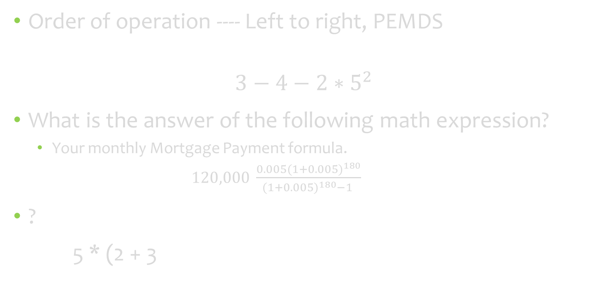
A little quick check on your math
Order of operation ---- Left to right, PEMDS
$$3−4−2∗5^{2}$$
What is the answer of the following math expression?
Your monthly Mortgage Payment formula.
$120,000 \frac{0.005(1+0.005)^{180}}{(1+0.005)^{180}−1 }$
?
5 * (2 + 3

Slide 6
Hello message
Name – Hold values
>>> name = "John"
>>> print("hello "+ name)
Variables --- It can be changed.
>>> name = "John"
>>> name = "Cindy"
>>> print("Hello "+ name) # what is the output?

Slide 7
Variable Name
Any
No special key words
Begin with a letter or _
Case sensitive
Use Descriptive Variable names
areaofCircle
----- Let IDE help you.

Slide 8
Variable
Name
Value --- Can be changed
Storage location ---- In memory

Slide 9
Variable type – use a type function to check type
Int
>>> type(3)
Float
>>> type(3.14159)
String
>>> type("Good Afternoon")
>>> type('Good Afternoon')
>>> type("1.243")

Slide 10
String Type
Double Quotation
Single Quotation
Q: How to print a message?
I ‘m fine.
Q: How to print ?
src=“great.jpg”

Slide 11
Why we need data type?
Avoid Meaningless operations.
>>> name = "John"
>>> age = 45
>>> com = name + age;
>>> name/name

Slide 12
Convert Type
Convert string to int
s = “1000”
c = int(s)
type(c)
type(s)

Slide 13
Convert Type
Convert string to float
>>> y = "45.6"
>>> x = float(y)
>>> y+5
>>> x+5

Slide 14
Convert Type
Convert float/int to string
>>> s = "The answer is "
>>> result = 1234.56
>>> s + result
>>> s + str(result)

Slide 15
Python input – String Type
Input
>>> s = input('--> ')
--> Monty Python's Flying Circus
>>> s
"Monty Python's Flying Circus"

Slide 16
The standard Input/Output
print --- output to stdout
input -- input from stdin
We need
File input/output
Graphic User Interface (GUI) I/O

Slide 17
Assignment statement
Python’s usage of “=“ is not the mathematical usage of the equal sign.
Assignment Statement: The left hand side must be a variable
Age = Age + 1 # Solve the equation? No
# Calculate right-hand side first and give the left hand side variable a new value.
Increase Age by 1.

Slide 18
Assignment statement
first = 'Sue'
last = 'Wong'
name = first + ' ' + last
--------------------------------------------------------------------------------------------
height = 12
area = width * height #problem with the code?

Slide 19
Input Statement Practice
Get input ----- the price of milk
Get input --- today’s temperature
Get input --- The school you attended
Get input --- age of student
Get input ---- Exam start time
Get input --- T-shirt size

Slide 20
Review
Editor --- Microsoft Visual Studio Code
Compiler - Python 3.7
Please create a folder practice on your J:/CSCI125.
Open the folder practice using Microsoft Visual Studio Code
Set VSCode to auto save all your files.

Slide 21
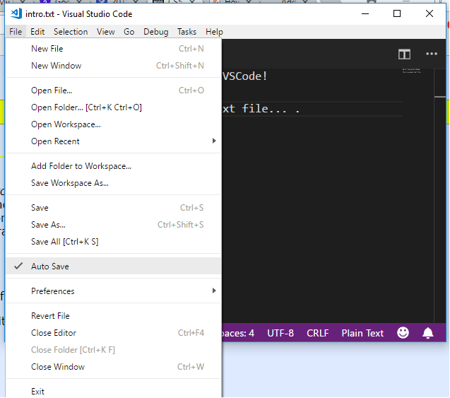

Slide 22
Python Comments
Comments that contradict the code are worse than no comments. Always make a priority of keeping the comments up-to-date when the code changes!
Each line of a block comment starts with a # and a single space
An inline comment is a comment on the same line as a statement. Inline comments should be separated by at least two spaces from the statement. They should start with a # and a single space.

Slide 23
Program Skills
Sit down and think about the instructions before you start to write any program
You may not skip instructions – computer is not smart enough to guess. Programming is about writing logical instructions.
Get the major steps first
** Please do not feel afraid to try , to type, to run code. Any kinds of errors are fine. **
** You can only learn coding by writing code **

Slide 24
Print a customized “Hello world” message.
Input
Get the input ---- What’s your name?
Process
Combine the hello message with your name
Output
Print the customized message

Slide 25
More Examples -- Computing Gross Pay
Display message: "How many hours did you work?"
Allow user to enter number of hours worked
Store the number the user enters in variables **** TYPE
Display message: "How much are you paid per hour?"
Allow the user to enter an hourly pay rate
Store the number the user enters in variables **** Type
Multiply hours worked by pay rate and store the result in memory
Display a message with the result of the previous step
This well-defined, ordered set of steps for solving a problem is called an algorithm

Slide 26
Practice Exercise: Work as a group
Create a program that asks the user to enter their name and their age. Print out a message addressed to them that tells them the year that they will turn 100 years old.
Create a program that asks the user to enter their name and their age. Print out a message addressed to them that tells them the year that they will turn 100 years old.

Slide 27
Practice Exercise: Work as a group
Create a program that convert temperature from Fahrenheit to Celsius.
°F to °C | Deduct 32, then multiply by 5, then divide by 9
°C to °F | Multiply by 9, then divide by 5, then add 32

Slide 28
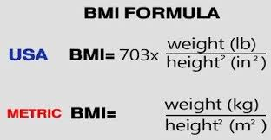
Practice Exercise: BMI Calculator
Create a simple BMI calculator that lets the user enter his or her weight(in pounds) and height(in inches), then calculates a person’s body mass index. A person’s BMI is calculated with the following formula: BMI = weightx703/ height^2.
Notes:
print("Formatted Number: "+"{:.2f}".format(y)); ---- If you need format, we will do it later.

Slide 29
Summary
Input
Algorithm
Output
Any challenge so far ?

Slide 30
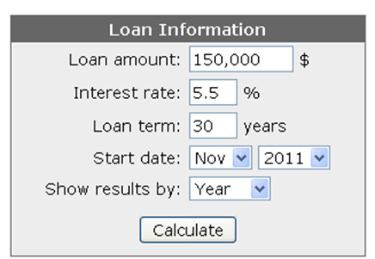
Bonus Exercise
Can you understand the logical behind mortgage calculator?
Monthly interest rate = Interest rate(annual) / 12
Monthly Payment =LoanAmount × (M𝑜𝑛𝑡ℎ𝑙𝑦 𝑖𝑛𝑡𝑒𝑟𝑒𝑠𝑡 𝑟𝑎𝑡𝑒)/(1−(1+M𝑜𝑛𝑡ℎ𝑙𝑦 𝑖𝑛𝑡𝑒𝑟𝑒𝑠𝑡 𝑟𝑎𝑡𝑒)^(−𝑛𝑢𝑚𝑏𝑒𝑟 𝑜𝑓 𝑚𝑜𝑛𝑡ℎ))
Testing data: Monthly payment is 851.68

